Slide 1

NAS-based Defense for Deep Learning-Architectural Side-Channel Attack

Slide 2
Attacks on Deep Learning
1. Attack on Input
For example: Membership Attack
2. Attack on Model
For example: Model Extraction Attack
3. Attack on Output
For example: Model Inference Attack

Slide 3
From users’ viewpoint to service providers’ viewpoint
1. Attack on Input
For example: Membership Attack
2. Attack on Model
For example: Model Extraction Attack
3. Attack on Output
For example: Model Inference Attack

Slide 4
Attacks on Model
1. Data Query-based Attack
White-box Attack assumes that attackers know the model architecture.
Black-box Attack assumes that attackers have the prior knowledge to generate shadow model.
In practice, the attackers require a large number of queries.

Slide 5
Attacks on Model
2. Side-Channel Information Attack
Memory and Timing Side-Channels
Power Side-Channel
Cache Side-Channel
Differential Analysis

Slide 6
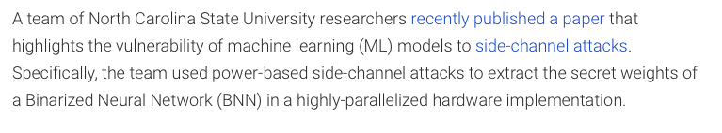
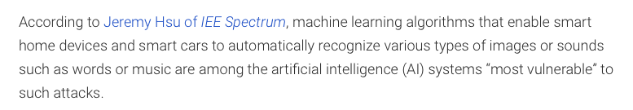
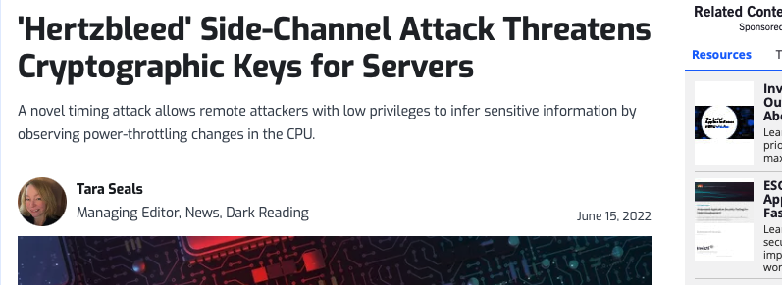

Examples

Slide 7
Motivation
We want to design an effective defense strategy for more stealthy Side-Channel Information Attack.

Slide 8
Side-Channel Defenses
1. Hiding-based Schemes
Use consumption-balancing techniques to make the consumption constant
2. Masking-based Schemes
Split the input into multiple independent shares to ensure that the computation consumption of these multiple shares is statistically independent.

Slide 9
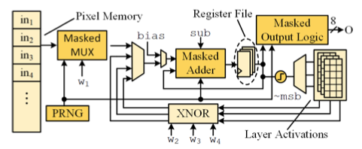
Limitation
1. Hiding-based Schemes
2. Masking-based Schemes
The proposed schemes are deployed on hardware circuits, lacking the portability and increase some extra costs.

Slide 10
Our Idea: Portable Defense Strategy
We attempt to propose a defense strategy from the design of architecture itself.

Slide 11
Challenges
When renewing the deep learning architecture
1. Maintain the performance of application as much as possible
2. Balance the resource consumption of each layer in the neural network
3. Reduce the increase of resource consumption as much as possible

Slide 12
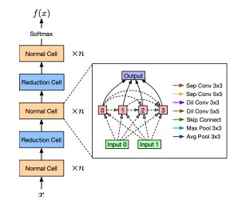
Neural Architecture Search (NAS)
1. Search Space
2. Search Policy
3. Search Metrics

Slide 13
NAS-based Defense for Deep Learning-Architectural Side-Channel Attack
Our Novel Design
For Search Space
Design Cells with balanced resource consumption
For Search Metrics
Performance Metrics and Resource Consumption Metrics
For Search Policy
Rely on Reinforcement Learning to obtain the search policy

